Slide 1

Subject Name:- Microprocessor & Microcontroller
Subject Code:- KEC-502
Unit No.:- 5
Lecture No.:- 4
Topic Name :- Arithmetic (mul,div,da) and Logical Instructions
Er. Preeti Verma
ECE Department

Slide 2
Multiplication, Division and Decimal adjust Instructions
Operation | Opcode | Operand | Description
Multiplication | MUL | A,B | [A]=[A]*[B]
Division | DIV | A,B | [A]=[A]/[B]
Decimal adjust | DA | A | Coverts binary addition to BCD
In case of multiplication one operand should we in register A and second operand must be in register B. After multiplication result in register A and B; the lower byte in A and upper byte in register B.
In case of divide , the numerator must be in register A and the denominator must be in register B. after divide the quotient is in register A and remainder in register B.
The divide instruction always makes CY=0 and OV=0 if denominator is not zero. If denominator zero (B=0) ,OV=1,indicate an error and CY=0.

Slide 3
Ex: In a semester exam, student has taken six courses. The marks of the student ( out of 25 ) and store in RAM locations 47H onwards. Find the average marks, and output it on port 1.
MOV R0,# 47H
MOV B,#06H
MOV R1,#06
MOV A,#00H
Back: ADD A,@R0
INC R0
DJNZ Back
DIV A B
MOV P1,A

Slide 4
Logical instructions
Logical operations in 8051 perform bitwise operations between the accumulator and data stored in a memory location, register, or data given by the programmer. The result of a logical operation is stored in the accumulator itself. The table given below lists the logical operations which can be performed by the 8051. [A]=Accumulator; [Rn]= register in register bank of RAM space.
Operation | Mnemonics | Description
AND | ANL A, Rn | [A]<-[A] AND [Rn]
 | ANL A, Address | [A]<-[A] AND [Data at Address]
 | ANL A, @Rn | [A]<-[A] AND [Data at Address in Rn]
 | ANL A, #data | [A]<-[A] AND [Data]
 | ANL Address, A | [Data at Address]<-[Data at Address] AND [A]
 | ANL Address, #data | [Data at Address]<-[Data at Address] AND [Data]

Slide 5
Logical instructions
Operation | Mnemonics | Description
OR | ORL A, Rn | [A]<-[A] OR [Rn]
 | ORL A, Address | [A]<-[A] OR [Data at Address]
 | ORL A, @Rn | [A]<-[A] OR [Data at Address in Rn]
 | ORL A, #data | [A]<-[A] OR [Data]
 | ORL Address, A | [Data at Address]<-[Data at Address] OR [A]
 | ORL Address, #data | [Data at Address]<-[Data at Address] OR [Data]
XOR | XRL A, Rn | [A]<-[A] XOR [Rn]
 | XRL A, Address | [A]<-[A] XOR [Data at Address]
 | XRL A, @Rn | [A]<-[A] XOR [Data at Address in Rn]
 | XRL A, #data | [A]<-[A] XOR [Data]
 | XRL Address, A | [Data at Address]<-[Data at Address] XOR [A]
 | XRL Address, #data | [Data at Address]<-[Data at Address] XOR [Data]

Slide 6
Logical instructions
Operation | Mnemonics | Description
Rotate left | RL A | Shifts the value in accumulator to the left
 | RLC A | Shifts the value in accumulator to the left through the carry.
Rotate right | RR A | Shifts the value in accumulator to the right
 | RRC A | Shifts the value in accumulator to the right through the carry.
Swap | SWAP A | Swaps the upper nibble of the accumulator with the lower nibble

Slide 7
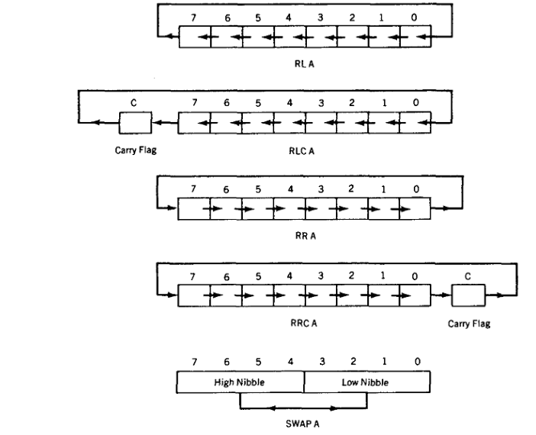
Rotate Instructions

Slide 8
Ex- Write a program to transfer value 41H serially( one bit at a time)via pin P2.1. Put two high at the start and end of the data. Send the byte LSB first.
MOV A, #41H
SETB P2.1
SETB P2.1
MOV R5, #8H
Here: RRC A
MOV P2.1, C
DJNZ R5, Here
SETB P2.1
SETB P2.1

Slide 9
Ex- Write a program to bring in data in serial form and send it out in parallel form. Let us take in data through port pin P0.0 and transmit it through P1.
MOV R0, #08H
SETB P0.0
Back: MOV C, P0.0
RRC A
DJNZ R0, Back
MOV P1,A
END

Slide 10
Ex- Port lines P0.0 to P0.3 are used to take in a 4-bit data from an input device. This data is to be displayed on 4 LEDs connected to port lines P1.4 to P1.7 of port 1. Write a program to do this.
MOV P0,#0FFH
MOV A, P0
ANL A, #0FH
SWAP A
MOV P1,A

Slide 11
Important Questions
What is the clock source for the timers in 8051?
Write a program to add all the digit in your ID number and save result in R3 register.
What is the clock source for timer?
Which register is used by multiply and divide instruction?
What are the applications of timer?

Slide 12
References
Text Books:
Mazidi Ali Muhammad, Mazidi Gillispie Janice, and McKinlay Rolin D., “The 8051 Microcontroller and Embedded Systems using Assembly and C”, Pearson, 2nd Edition,2006
Shah Satish, “8051 Microcontrollers MCS 51 Family and its variants”, Oxford,2010
Reference Books:
1. V. Udayashankara, M.S. Mallikajunaswamy, “8051 Microcontroller Hardware, Software and Applications”, McGraw-Hill, 2017

Slide 13
Thank You

